Slide 1
ANTRIAN ONLINE BPJS KESEHATAN
RS. BHAKTI HUSADA II PURWAKARTA

Slide 2
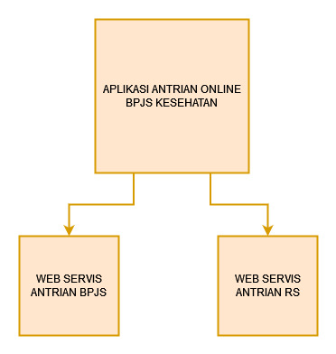
SKEMA WEB SERVIS

Slide 3
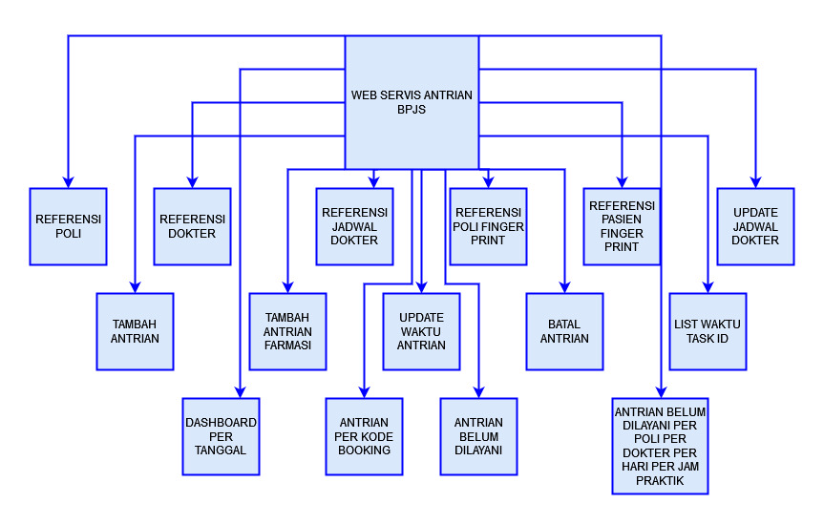
WEB SERVIS BPJS

Slide 4
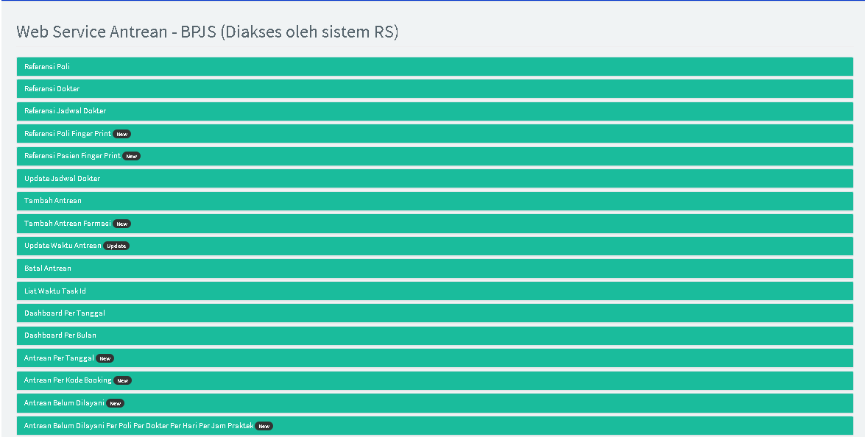

Slide 5
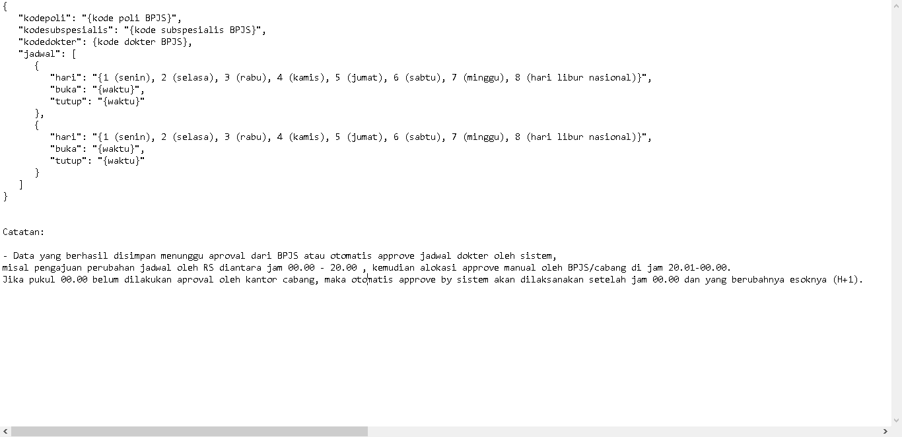
HTTP REQUEST METHOD POST UPDATE JADWAL DOKTER

Slide 6
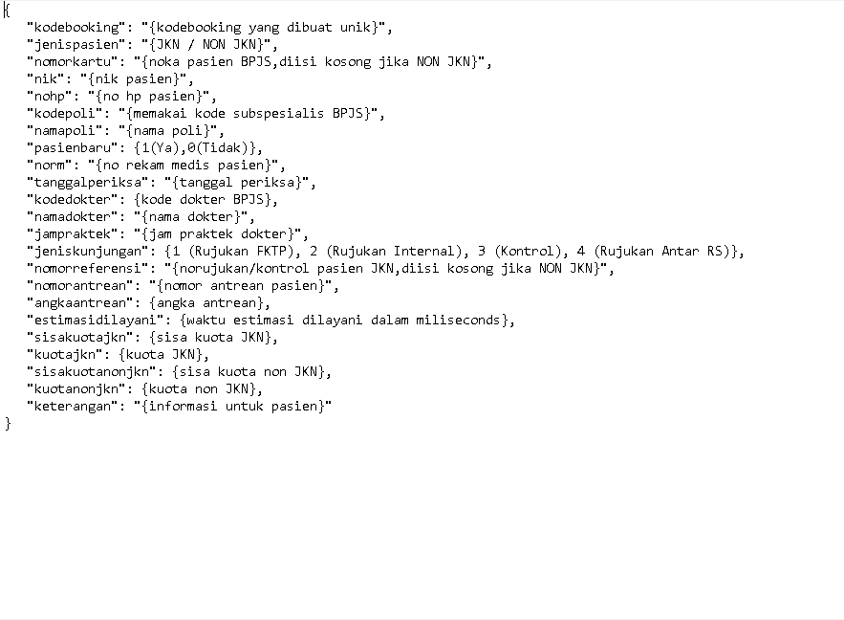
HTTP REQUEST METHOD POST TAMBAH ANTREAN

Slide 7
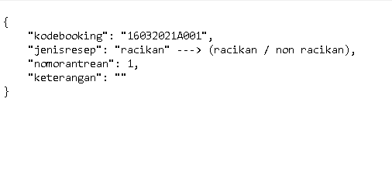
HTTP REQUEST METHOD POST TAMBAH ANTREAN FARMASI

Slide 8
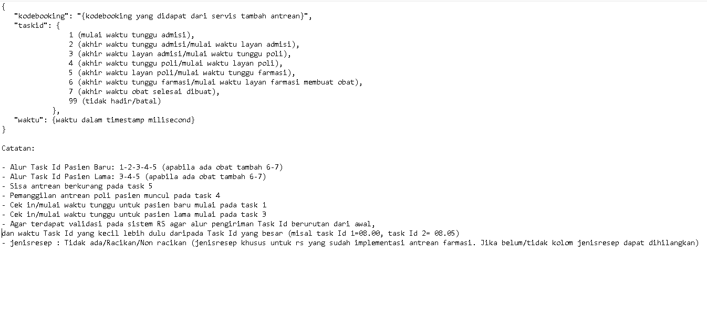
HTTP REQUEST METHOD POST UPDATE WAKTU ANTRIAN

Slide 9
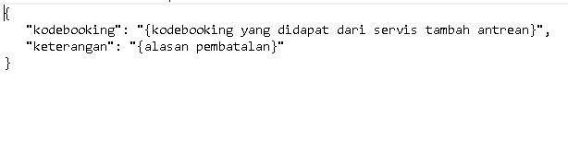
HTTP REQUEST METHOD POST BATAL ANTRIAN

Slide 10
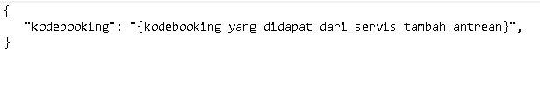
HTTP REQUEST METHOD POST LIST WAKTU TASK ID

Slide 11
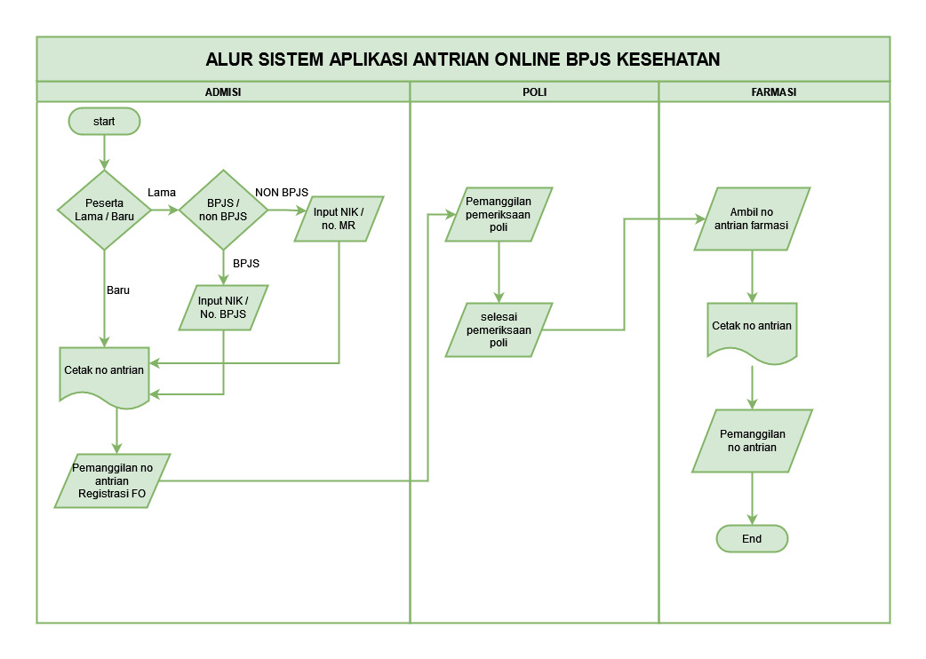

Slide 12
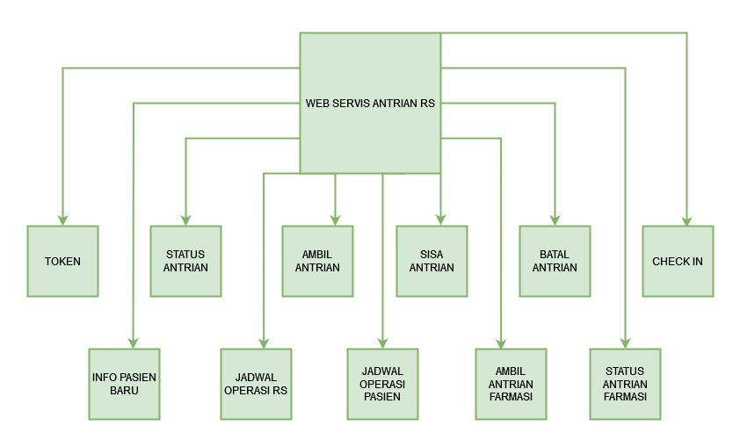
WEB SERVIS RS

Slide 13
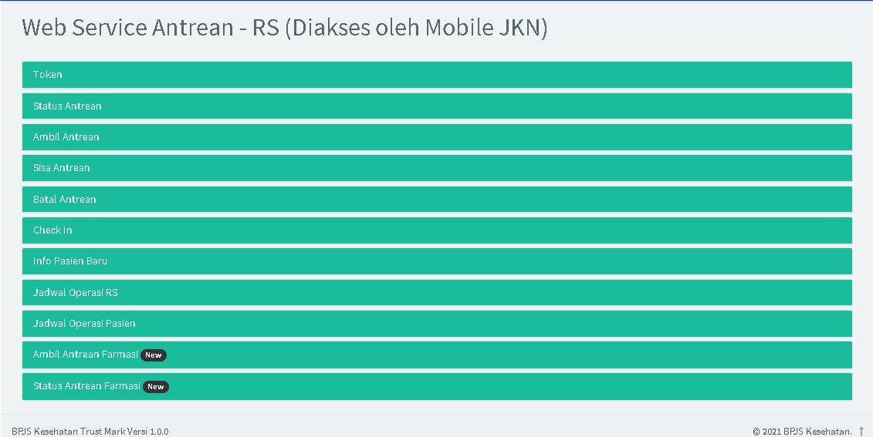

Slide 14
Required Hardware & Network
PC SERVER
Domain & SSL
IP Public

Slide 15
TERIMA KASIH

